Slide 1
EMPLOYEE SALARY PREDICTION USING MACHINE LEARNING
CAPSTONE PROJECT
Presented By:
Student Name: Kushagra Verma
AICTE ID: STU683b1c79e9afb1748704377
University/College Name: University of Lucknow

Slide 2
OUTLINE
Problem Statement (Should not include solution)
System Development Approach (Technology Used)
Algorithm & Deployment (Step by Step Procedure)
Result
Conclusion
Future Scope(Optional)
References

Slide 3
Problem Statement
Employee salary prediction using machine learning involves developing a model that can accurately forecast salaries based on various factors such as job title, experience, education, location, and industry. Some potential machine learning algorithms for this task include:
Collecting and preprocessing relevant data.
Exploring feature engineering techniques.
Selecting and training a suitable model.
Evaluating model performance and tuning hyperparameters.

Slide 4
System Approach
System Requirements:
Processor- 12th Gen Intel(R) Core(TM) i5-12450H 2.00 GHz
RAM- 16GB
System type- 64-bit operating system, x64-based processor
Library required to build the model:
Scikit-learn: Python library for machine learning.
Jupyter Notebook: Interactive environment for data science and machine learning.
Pandas: Python library for data manipulation and analysis.
NumPy: Python library for numerical computing.

Slide 5
Algorithm & Deployment
Algorithm:
Loading the dataset in Jupyter file.
Removing the redundant data from the dataset.
Importing and installing the libraries.
Making the Outlier.
Label encoding the dataset.
Training the model using various machine learning algorithms.
Selecting and saving the best model.
Deployment:
Deploying the model using streamlit and pynrok.

Slide 6
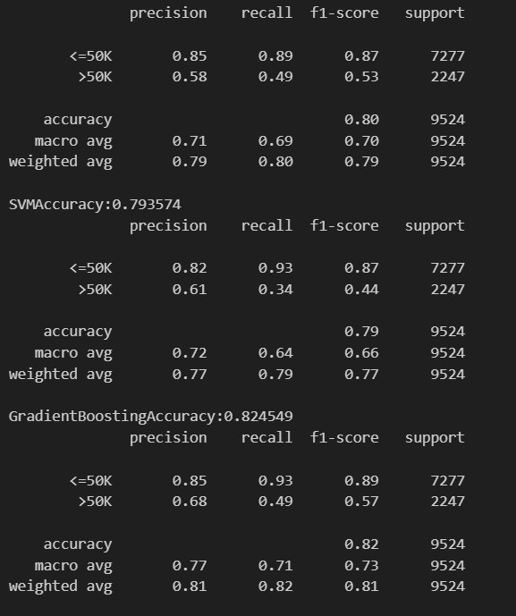
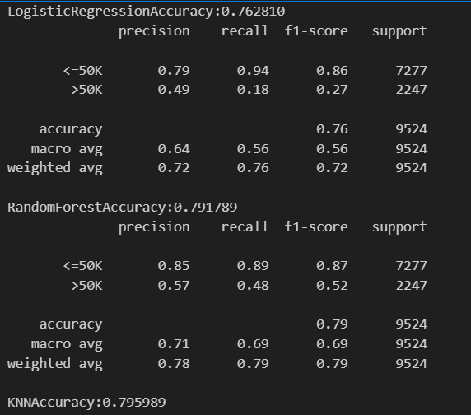
Result

Slide 7
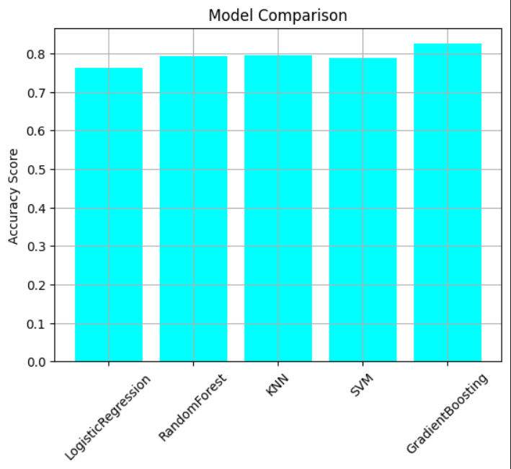
Result

Slide 8
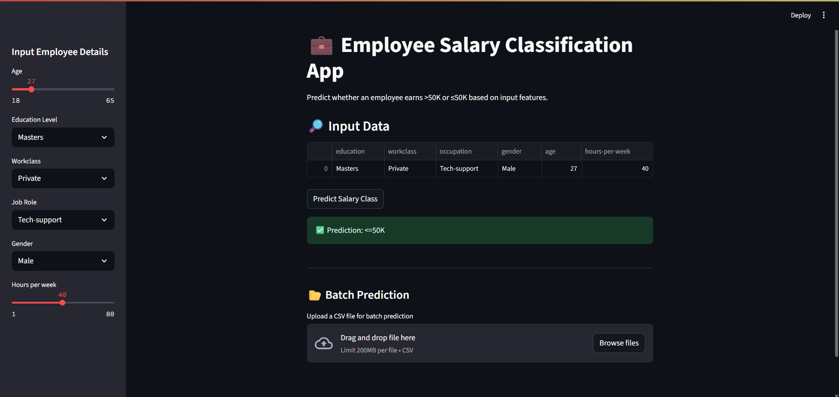
Result

Slide 9
Result
GitHub Link :
https://github.com/Kushagra-webdev/Employee-salary-prediction.git

Slide 10
Conclusion
Data preparation and feature engineering
Selecting and training a suitable algorithm
Evaluating model performance
Deploying the model in a production-ready environment

Slide 11
Future scope(Optional)
Potential Developments:
Increased accuracy: Improved algorithms and data quality
Integration with HR systems: Seamless salary prediction and management
Real-time predictions: Dynamic salary forecasting and adjustments
Explainable AI: Transparent and interpretable salary predictions
Emerging Trends:
AI-powered HR: Automated HR processes and decision-making
Predictive analytics: Forecasting employee turnover, performance, and development
Personalized compensation: Tailored salary packages and benefits

Slide 12
References
Online Resources
Kaggle: Machine learning competitions and datasets
GitHub: Open-source machine learning projects and code
Books
"Python Machine Learning" by Sebastian Raschka
"Hands-On Machine Learning with Scikit-Learn, Keras, and TensorFlow" by Aurélien Géron

Slide 13
THANK YOU

